Slide 1
RTOS INTERNALS
1
Internal workings of RTOS

Slide 2
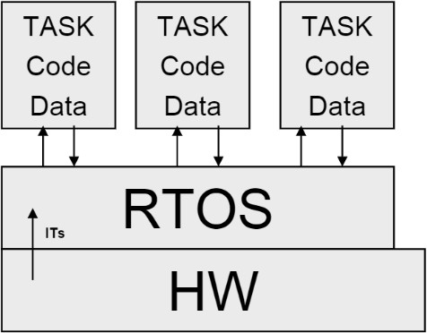
RTOS: Components
2
Kernel
  System resource manager
  Includes the Scheduler
    Schedules tasks for execution
Task
  Implements specific task code
  Has its own ‘state’ / ‘context’
    PC, Registers, Stack, etc.
ISRs
  Interrupt service routines
Layering starts!
  Tasks have to go through the RTOS
    To interact with HW!

Slide 3
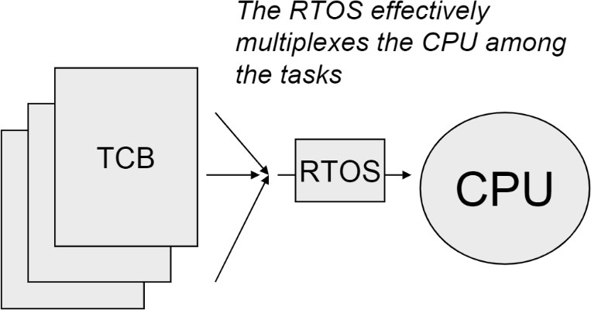
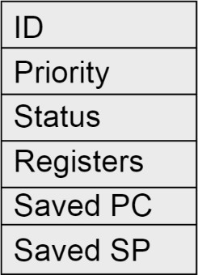
RTOS: Task structure
3
Task is composed of:
  Task code: Implementing function
  Task data: Variables local to the task
  Task ‘state’ / ‘context’: What the task is doing
Task Control Block (TCB)
  A data structure storing task properties
    When Task is not running
  Unique per task
  Typical TCB structure:

Slide 4
RTOS: Task state / status
4
Executing
  Running on the CPU
Ready
  Could run, but can’t since another is running on the CPU
Blocked
  Cannot run, waiting for some resource to be available
Dormant
  Created, but not ready to run yet
Terminated
  No longer active
RTOS implements an FSM for each task Manages task state transitions

Slide 5
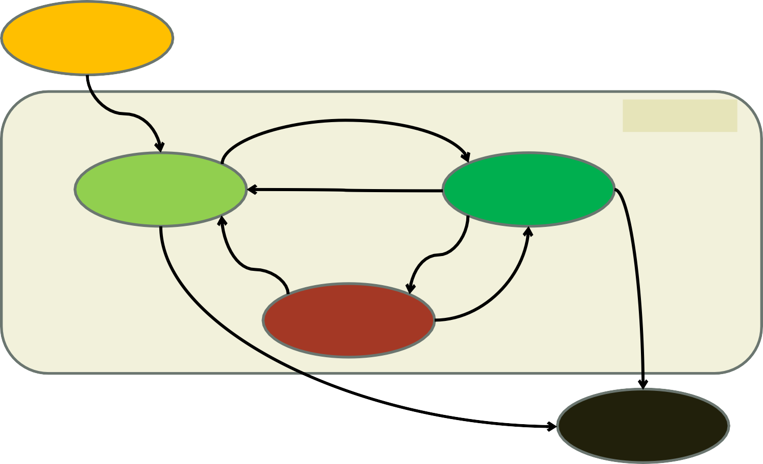
RTOS: Task state machine
5
Task just created
Dormant
Task scheduled
Task active
Task activated
Ready
Task yields
Executing
Task waiting Task got resrc
Task killed
Blocked
Task got resrc
Task killed
Terminated

Slide 6
RTOS: Scheduler
6
The RTOS Scheduler
  Implements the task state machine
  Maintains a list of tasks in 2 states
    Executing
    Ready
    Other states don’t matter much
      Blocked task has to unblock itself
      Dormant task has to be activated
      Terminated task is anyway dead
  Switches between tasks
    Context switch algorithm
      Save current task’s context into its TCB
      Find new task to run
      Restore context from its TCB
      Run new task

Slide 7
RTOS: Task switching modes
7
A task/context switch in an RTOS could be:
  Non-preemptive (Cooperative)
    Passive Scheduler
    A running / executing task keeps running till:
      It yields CPU time voluntarily
      It gets blocked on some unavailable resource
    Depends on the good behavior of all tasks
    Rarely used in today’s systems
  Preemptive
    Proactive Scheduler
    Scheduler switches tasks abruptly due to:
      A time slice expiry (for equal priority scenarios)
      A higher priority task / event (interrupt)

Slide 8
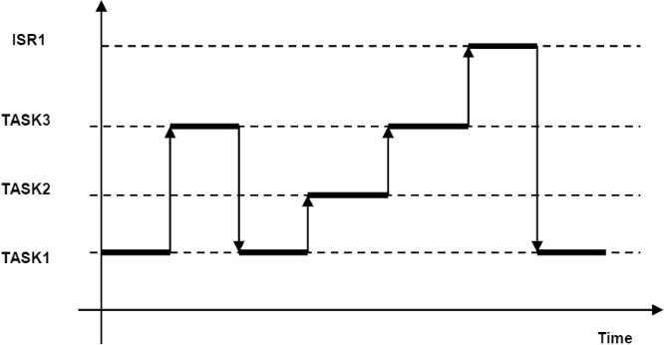
RTOS: Preemptive scheduler functioning
8
System with 3 tasks
  Task1, Task2, Task3, and 1 interrupt (handled by ISR1)
  Priority wise:
    ISR1 > P(Task3) > P(Task2) > P(Task1)
Scheduler runs highest priority task
  Lower priority task is ‘suspended’
  Lower priority task ‘resumes’ run
    After higher priority task is done
ISR1 is at highest priority
  It suspends any and all tasks to run
Sample RTOS trace

Slide 9
RTOS: Scheduling policies
9
Some policies used for scheduling task execution
  Round-robin (RR)
    All tasks at same priority
    CPU time is sliced across different tasks
    Called ‘fair’ scheduling
  Fixed priority – Rate monotonic (RM)
    Priority preemptive kernel
    Set of periodic tasks
    Tasks with shorter periods are given higher priority
  Dynamic priority – Earliest deadline first (EDF)
    Priority pre-emptive kernel
    Ready task with earliest deadline has highest priority

Slide 10

RTOS: Shared code problem
10
2 equal priority tasks – share code and data
int tmp; // shared global variable
Task 1 (use sensors 1,2) Task 2 (use sensors 3,4)
// Sensor1=10 ⟶ Sensor2=10
// Sensor3=20 ⟶ Sensor4=20
void task (int sen1, int sen2)
{
tmp = read(sen1); write(sen2) = tmp;
}
void task (int sen1, int sen2)
{
tmp = read(sen1); write(sen2) = tmp;
}
task() is called non-reentrant

Slide 11
RTOS: Re-entrancy
11
RTOS Scheduler keeps switching tasks
  Depending on various policies and conditions
    Time slice expiry
    Priority pre-emption
    Interrupt servicing
    One/more of the above!
Hence, all task (as well as other) functions
  Need to be re-entrant
Re-entrancy
  Multiple invocations can safely run concurrently
  System behavior does not change if a function is reentered
    Any number of times from any number of points
Re-entrant functions
  Should not use globals
  Should not call any non-re-entrant functions

Slide 12
RTOS: Semaphore
12
Semaphore
  A variable or data-type used to control access
    To a common resource
    By multiple tasks / threads / processes
    In a concurrent system (like an OS/RTOS)
Types:
  Counting semaphore
    Supports arbitrary resource count
    Used for controlled access to a pool of resources
  Binary semaphore
    Supports binary access (available / unavailable)
    Used for controlled access to a single resource

Slide 13
RTOS: Mutex
13
Mutex
  A locking mechanism used to control access
    To a single resource
    By multiple tasks / threads / processes
    In a concurrent system (like an OS/RTOS)
  Behaves very much like a binary semaphore
    Implements mutual exclusion concurrency
  Has concept of ownership
    Only the task / thread that locked it can unlock it
In both mutex and semaphore
  A task wanting to use an unavailable resource
    Has to wait – go to a ‘blocked’ state

Slide 14
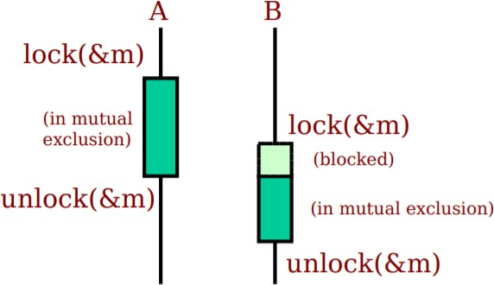
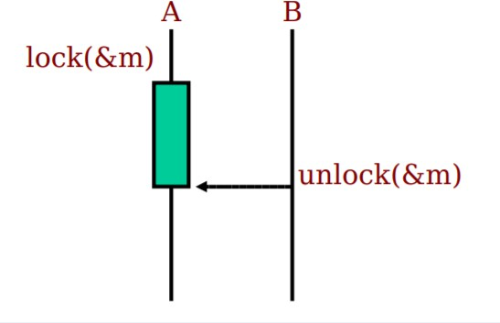
RTOS: Mutex vs Semaphore
14
Mutex
Semaphore

Slide 15
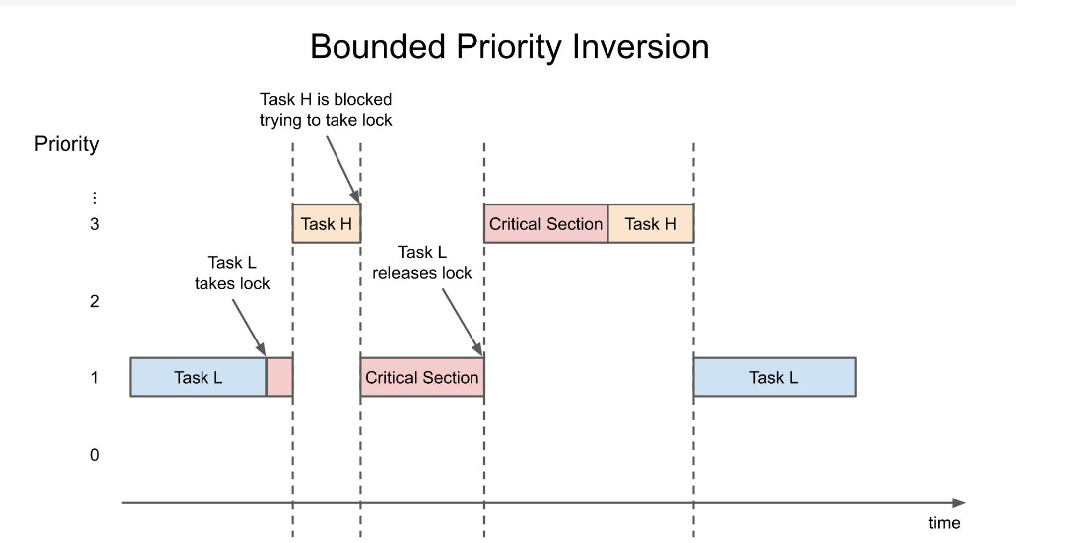
RTOS: Priority Inversion
15

Slide 16
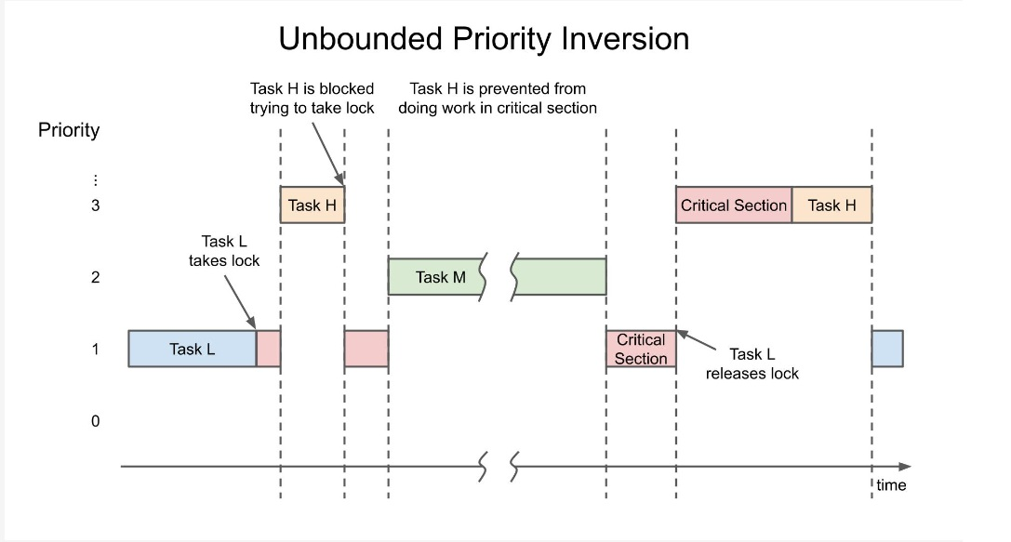
RTOS: Priority Inversion
16

Slide 17
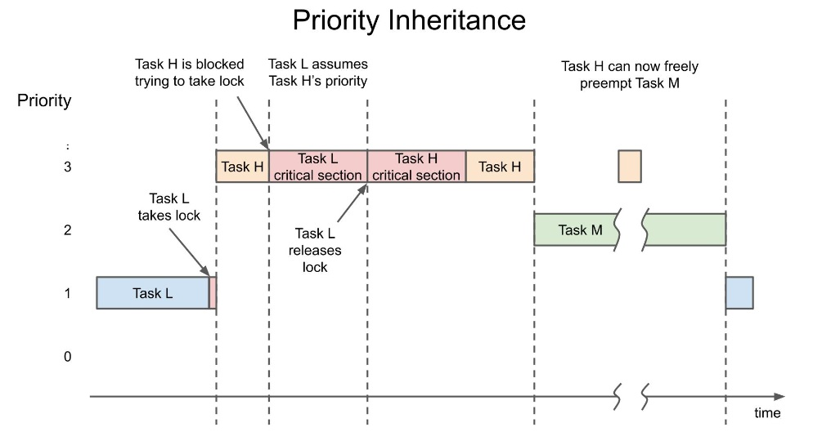
RTOS: Priority inheritance
17

